Slide 1

Greenspace Mapping Project
Greenspace Alliance of Canada’s Capital

Slide 2
Why?
We need to answer two questions:
Council will pursue the target for total greenspace, in the form of open space and leisure lands, across large areas of the urban area, to fulfill objectives expressed in the Greenspace Master Plan. A target of 4.0 hectares per 1000 population, or approximately 16 per cent to 20 per cent of gross land area, will be pursued.
How close are we to this area target?
Council supports a target of providing the open space and leisure land that is referred to in policy 5, within 400 metres of all homes in primarily residential areas in the urban area.
How close are we to this access target?

Slide 3
What?
Identify and map every parcel of greenspace larger than a given threshold within the urban part of Ottawa
Classify greenspace
by type
by ownership
by protection status
by condition
Monitor the evolution of the total area of greenspace over time
Determine the distance between these greenspace areas and residents

Slide 4
How to identify and map
City provided Geo files
Parks file
0 – Dedicated Parkland
1 – New Park – Constructed – Not circulated
2 – New Park – Registered – Not constructed
3 – New Park – Not registered
4 – Hydro Corridor
5 – Open Space
6 – Pedestrian Plaza
7 – Recreational Trail
8 – Stormwater Management Area
9 – Urban Natural Feature
11 – Woodlot
Urban Natural area file

Slide 5
How to get classification information?
Information contained in the City provided parks and urban natural area files
Information contained in the Urban Natural Area Environmental Evaluation Study report (2005)
Individual pdf map and rtf text file for each of 187 Urban Natural Areas

Slide 6
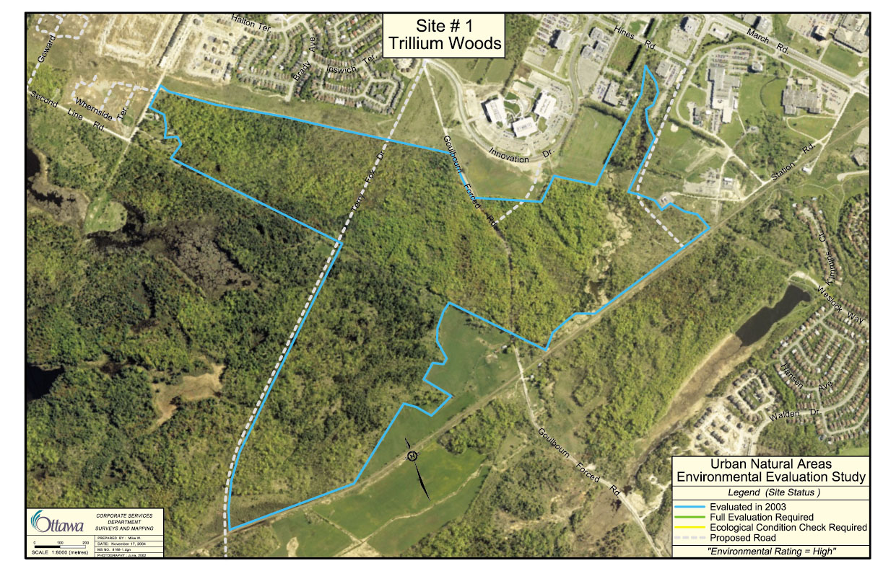

Slide 7
UNA 1: Trillium Woods
Description:
- upland forest complex largely over rugged, thinly buried Precambrian Shield bedrock landscape with extensive deciduous and mixed forest cover; large area of major deciduous forest (Trillium Woods); wetlands consisting of shallow beaver ponds and seasonal woodland pools plus headwaters portion of Shirley’s Brook along southern edge.
Site details
a) Size:
134 ha.
b) Ownership:
City and private

Slide 8
Ecological functions
a) Connectivity:
- within Carp Hills complex immediately adjacent to City owned protection area (‘Regional Conservation Lands’) to north and west; UNA 2 (Watts Creek Forest) adjacent to south and southwest; UNA 9 (Klondike Road Park) and UNA 10 (Morgans Grant park) ca. 250 m to east.
b) Interior habitat:
Extensive area; ca 57 ha
c) Disturbance and condition:
- High native flora Co-efficient of Conservation rating (4.65.), with 63 high-rated Coefficient of Conservation species;
- informal pathways evident in several areas as well as formal paved recreational pathway at eastern end;
- frequent evidence of former tree cutting and former agricultural activity (Pasturing) in western half;

Slide 9
Data elements
ID: Name
Location: coordinates
Area: in ha
Type:
Accessible: Park, Urban Natural Area, Recreational Pathway, Open Space, Flood plain, Storm water facility, Allotment garden, other
Restricted: School Ground, Golf Course, Cemetery, Hydro corridor, other
Ownership:
Public
Federal, Provincial, Municipal
Private

Slide 10
Data elements (cont’d)
Protection status
National Historic Site
Provincially Significant Wetland
Significant Woodland
Area of Natural and Scientific Interest
Urban Natural Feature
Environmental Protection Zoning
Major Open Space Zoning

